Slide 1
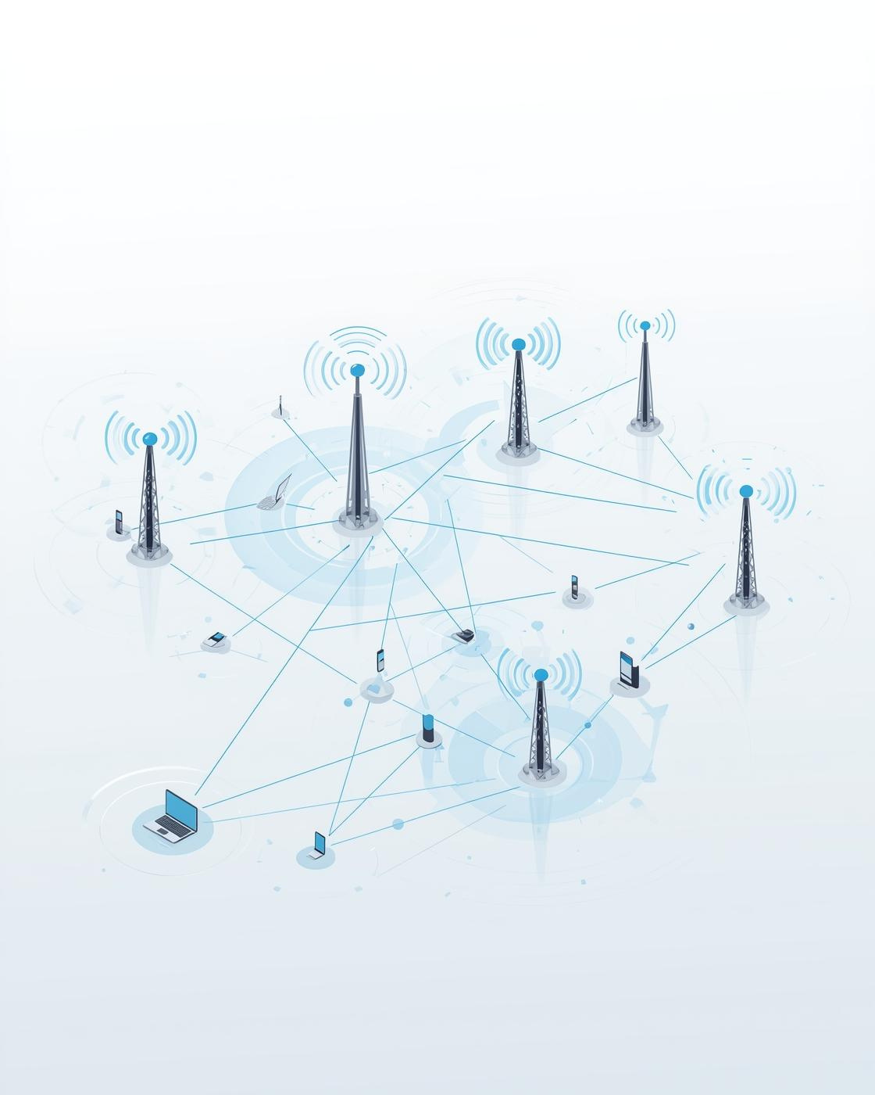
WiMAX: A standard designed for long-range wireless broadband access
Presented by
Name : Shafinaj Jerin Asha
ID : IT-21031
Session : 2020-2021
Course Title : Wireless Communication
Presented To
Dr. Nazrul Islam
Associate Professor
Dept. of ICT, MBSTU

Slide 2
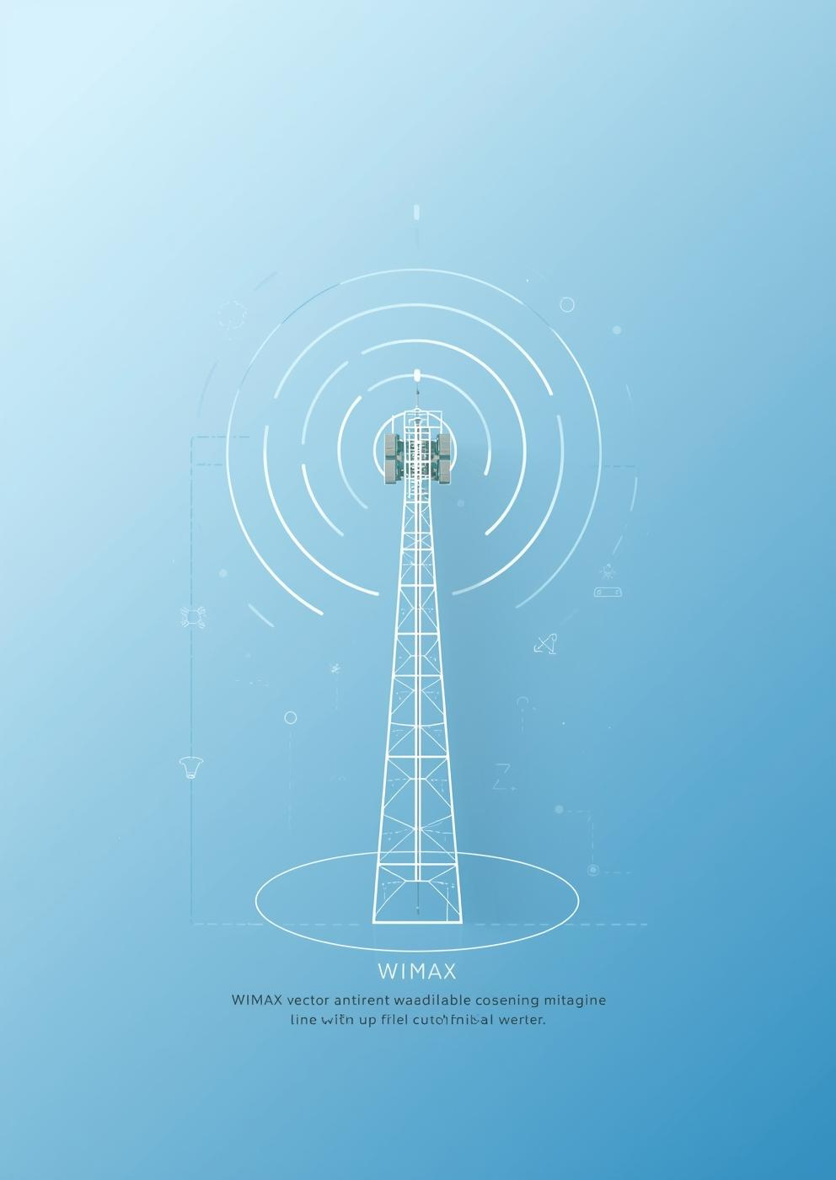
Introduction
WiMAX
which stands for Worldwide Interoperability
for Microwave Access.
In simple terms, WiMAX is a wireless communication technology that provides high-speed broadband access over long distances. WiMAX bridges the gap between Wi-Fi and mobile cellular technologies. It can serve both fixed users — like homes and offices — and mobile users — like laptops or vehicles.
So in this presentation, we’ll explore WiMAX’s history, how it works, its features, advantages, and how it compares to other technologies.
2

Slide 3
WiMAX Evolution
2005 IEEE Standard
2009 First Deployment
2018 Global Adoption
2001 Launch
WiMAX was officially launched, enabling broadband access.
IEEE standardized WiMAX under the 802.16 protocol.
The first WiMAX networks were deployed commercially worldwide.
WiMAX saw increased global adoption across multiple regions.
It was considered a big step forward at the time, offering broadband-like speeds without the need for physical infrastructure — especially beneficial for developing nations.
3

Slide 4
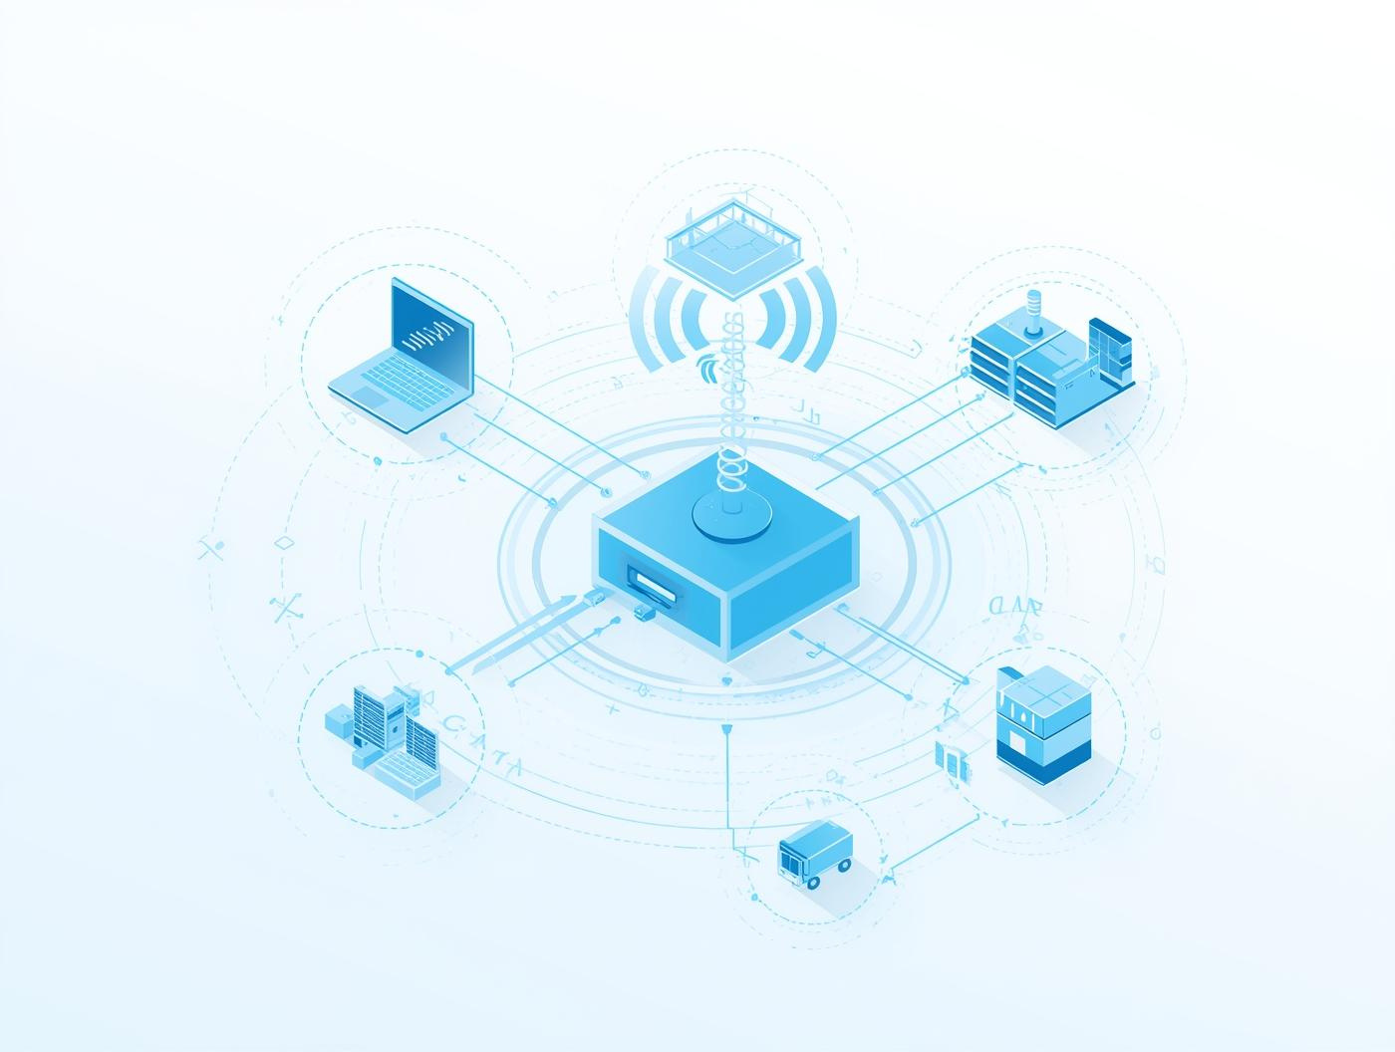
WiMAX Architecture
WiMAX architecture is built on a point-to-multipoint model.
At the center, we have the Base Station, which transmits signals to and from multiple Subscriber Stations — these are the devices or antennas installed at user locations.
This architecture supports both fixed WiMAX, for stationary users, and mobile WiMAX, which allows mobility like a cellular network
Architecture
WiMAX architecture supports high-speed broadband access across distances.
4

Slide 5
How WiMAX Works
Understanding the Key Principles of WiMAX
Signal Transmission
Modulation Techniques
Network Infrastructure
WiMAX utilizes advanced signal transmission techniques to deliver high-speed broadband access over large distances, ensuring reliable connectivity in various environments.
The technology employs modulation techniques such as OFDM (Orthogonal Frequency Division Multiplexing) to efficiently manage bandwidth and improve data throughput, enabling multiple users to connect seamlessly.
WiMAX relies on a robust network infrastructure that includes base stations and subscriber units, facilitating a comprehensive network that supports both fixed and mobile broadband applications.
5

Slide 6

WiMAX Spectrum Management
Frequency Bands
Bandwidth Allocation
WiMAX utilizes multiple frequency bands for various applications.
Efficient bandwidth allocation enhances overall network performance.
Licensing
Interference Mitigation
WiMAX operates under licensed and unlicensed spectrum agreements.
Effective strategies reduce interference and improve connectivity.
6

Slide 7

Key Features of WiMAX
High Speed
Long Range
Scalability
WiMAX provides broadband access at impressive speeds worldwide.
It enables connectivity over long distances with minimal loss.
WiMAX networks can scale efficiently to meet growing demands.
Flexibility
Interoperability
The technology supports various deployment scenarios and configurations.
WiMAX is designed to work seamlessly with multiple devices.
7

Slide 8
Advantages of WiMAX
Key Benefits of Wireless Connectivity Technology
High-Speed Access
Cost-Effective Solutions
Wide Coverage
WiMAX provides high-speed broadband connectivity over long distances, facilitating seamless internet access even in remote areas.
By utilizing existing infrastructure and reducing deployment costs, WiMAX offers affordable connectivity options for both consumers and businesses.
The technology is designed to cover extensive areas, providing broad network coverage that supports numerous users simultaneously.
8

Slide 9


WiMAX Compared to Other Technologies
Compared to Wi-Fi, WiMAX offers a much greater range and higher data speeds. While Wi-Fi is ideal for small areas like homes, offices, or cafes, WiMAX can cover entire cities or regions.
WiMAX
Compared to LTE, which eventually became the global standard for mobile broadband, WiMAX was introduced slightly earlier. However, LTE gained more industry support, especially from telecom giants, which led to its wider adoption.
.
LTE
Still, WiMAX paved the way for many features that LTE and even 5G networks later adopted.
9

Slide 10



WiMAX Applications in Everyday Life
Connectivity
Expansion
Education
Internet Service Providers used it to deliver last-mile connectivity.
It was also used for public safety communications, connecting police and emergency services in remote areas.
Many schools and universities used WiMAX to provide wireless campus-wide internet.
In developing countries, it became a reliable solution for connecting rural communities.
So, while it might not dominate headlines today, WiMAX played a major role in expanding global internet access.
10

Slide 11
Scalability in WiMAX
Network Expansion
Resource Allocation
User Capacity
WiMAX networks can efficiently grow with increasing user demands.
Dynamic resource allocation allows for optimal bandwidth distribution.
WiMAX supports a large number of simultaneous users seamlessly.
Flexible Infrastructure
Future-Proofing
The infrastructure can adapt to varying geographic requirements easily.
WiMAX technology is designed to evolve with emerging needs.
12

Slide 12
Security Measures
Encryption
Authentication
Firewalls
Encryption protects data during transmission and storage processes.
Authentication verifies user identities before granting network access.
Firewalls block unauthorized access to the network's data.
Intrusion Detection
Data Backup
Intrusion detection systems monitor for suspicious network activities.
Regular data backups ensure recovery from potential security breaches.
14

Slide 13
Cost-Effectiveness of WiMAX
Affordability
Reduced Infrastructure
WiMAX provides cost-effective broadband solutions for rural areas.
Deployments require less infrastructure investment compared to traditional methods.
Scalable Solutions
Lower Operational Costs
WiMAX enables scalable solutions to meet growing connectivity demands.
Operating costs are significantly lower, enhancing profitability for providers.
15

Slide 14
Interoperability in WiMAX
Interoperability means that WiMAX devices made by different manufacturers can work on the same network without compatibility issues.
Device Compatibility and Standards
Network Integration Challenges
Future of Interoperability
Emphasizes the need for evolving standards and solutions.
Ensures smooth communication among different devices.
Overcoming barriers for seamless connectivity is essential.
17

Slide 15
Quality of Service (QoS)
Prioritizing Network Traffic Efficiency
Reducing Latency for Better Experience
Ensuring Reliability and Stability
QoS manages bandwidth for optimal performance.
Low latency enhances user experience significantly.
Consistent performance is crucial for applications.
18

Slide 16
Range and Coverage
A single WiMAX tower can cover up to 50 kilometers for fixed access, and about 5 to 15 kilometers for mobile access. This large range allows it to connect entire towns or villages using only a few base stations — far beyond what Wi-Fi can achieve.
Extensive Reach
Versatile Applications
WiMAX provides broad wireless coverage over large distances effectively.
It supports various use cases in urban and rural settings.
19

Slide 17
CONCLUSION
To conclude, WiMAX played a crucial role in the evolution of wireless broadband technology. It provided high-speed internet to places that were previously unreachable and demonstrated how powerful wireless connectivity can be.
Although newer technologies like LTE and 5G have taken the spotlight, WiMAX’s legacy remains significant. It served as a stepping stone for the next generations of broadband technology and helped bridge the global digital divide.

Slide 18

The Future of WiMAX
Technology Innovations
Even though LTE and 5G have largely taken over the broadband landscape, WiMAX continues to evolve. It’s now used in specialized applications — like industrial automation, private networks, and IoT connectivity — where its reliability and simplicity still make sense.
In essence, WiMAX may not be the future of mainstream mobile broadband, but it still has a place in certain sectors that need dependable wireless communication.
Innovations

Slide 19
Thank You

